Slide 1
Mastering NT Greek
13. Third Declension Nouns
By Ted Hildebrandt © 2003
Baker Academic

Slide 2
PAI Verb Chant
λύω λύομεν
λύεις λύετε
λύει λύουσι(ν)

Slide 3
2-1-2 Paradigms - Chant this
2 1 2
λόγος γραφή ἱερόν
λόγου γραφῆς ἱεροῦ
λόγῳ γραφῇ ἱερῷ
λόγον γραφήν ἱερόν
λόγοι γραφαί ἱερά
λόγων γραφῶν ἱερῶν
λόγοις γραφαῖς ἱεροῖς
λόγους γραφάς ἱερά

Slide 4
The "is" verb PAI -- εἰμί
εἰμί ἐσμέν εἶ ἐστέ ἐστί(ν) εἰσί(ν)

Slide 5
Imperfect εἰμί (a big one)
ἤμην ἦμεν ἦς ἦτε ἦν ἦσαν

Slide 6
Person Personal Pronoun Chant
Singular Plural
Nom. ἐγώ σύ ἡμεῖς
Gen. μου σου ἡμῶν Dat. μοι σοι ἡμῖν Acc. με σε ἡμάς
αὐτός, αὐτη, αὐτό (he, she, it)

Slide 7
Present Middle/Passive Indicative
λύομαι, -ομεθα -ῃ, -εσθε -εται, -ονται
I am loosed/am being loosed
I loose myself/am loosing [for myself]

Slide 8
Shape of the Future in Greek
λύσω λύσομεν I will loose We will loose
λύσεις λύσετε You will loose You all will loose
λύσει λύσουσι(ν) S/he/it will loose They will loose
Chant this one

Slide 9
Future Middle Paradigm
λύσομαι -όμεθα -ῃ -εσθε -εται -ονται
I will loose (for myself) We will loose (for ourselves) …

Slide 10
Demonstrative and Relative Pronouns Summary
ἐκεῖνος, ἐκείνη, ἐκεῖνο = that
οὗτος, αὕτη, τοῦτο τούτου, ταύτης, τούτου = this
ὅς ἥ ὅ = Relative (who, which) οὗ ἧς οὗ

Slide 11
Imperfect Active Paradigm of λύω
Chant: ἐλυον, ν, ς, ε, μεν, τε, ν I was loosing, …

Slide 12
Imperfect Middle/Passive (IM/PI)
Chant: ἐλυόμην ου, ετο, ομεθα, εσθε, οντο
I was being loosed

Slide 13
Rapping the Lord’s Prayer
Πάτερ ἡμῶν ὁ ἐν τοῖς οὐρανοῖς father our the one in heaven
ἁγιασθήτω τὸ ὄνομά σου make holy name your
ἐλθέτω ἡ βασιλεία σου let come kingdom your
γενηθήτω τὸ θέλημά σου, let be will your

Slide 14
Introduction to Third Declension Nouns
Second declension: omicron ending nouns (usually masculine or neuter – λὀγος, but ὁδός, ἡ)
First declension: eta or alpha ending nouns (usually feminine – γραφή but προφήτης, ου, ὁ)
Third declension: consonant ending nouns (χάρις, πίστις, ὄνομα)
Built off the genitive: take the ος off the genitive ending to get the stem

Slide 15
3 Third Declension Nouns to Master
χάρις, χάριτος, ἡ = grace (τ/δ stem)
Singular Plural
Nom. χάρις χάριτες
Gen. χάριτος χαρίτων
Dat. χάριτι χάρισι(ν)
Acc. χάριτα χάριτας
(χάριν)
χάριν is an alternate accusative form.
Chant this one.

Slide 16
3 Third Declension Nouns to Master
πίστις, πίστεως, ἡ = faith (ι stem)
Singular Plural
Nom. πίστις πίστεις
Gen. πίστεως πίστεων
Dat. πίστει πίστεσι(ν)
Acc. πίστιν πίστεις
Chant this one.

Slide 17
3 Third Declension Nouns to Master
ὄνομα, ὀνὄματος, τό = name (ματ stem)
Singular Plural
Nom. ὄνομα ὀνόματα
Gen. ὀνόματος ὀνομάτων
Dat. ὀνόματι ὀνόμασι(ν)
Acc. ὄνομα ὀνόματα
Chant this one.

Slide 18
3rd Declension Chantables
χαρίς ὄνομα, πίστις
χάρις ὄνομα πίστις
χάριτος ὀνόματος πίστεως
χάριτι ὀνόματι πίστει
χάριτα ὄνομα πίστιν
χάριτες ὀνόματα πίστεις
χαρίτων ὀνομάτων πίστεων
χάρισι(ν) ὀνόμασι(ν) πίστεσι(ν)
χάριτας ὀνόματα πίστεις

Slide 19
Rho final stems
πατήρ, πατρός, ὁ = father
Singular Plural
Nom. πατήρ πατέρες
Gen. πατρός πατέρων
Dat. πατρί πατράσι(ν)
Acc. πατρά πατέρες

Slide 20
-ευ final stems
ἱερεύς, -εώς, ὁ = priest
Singular Plural
Nom. ἱερεύς ἱερεῖς
Gen. ἱερέως ἱερέων
Dat. ἱερεῖ ἱερεῦσι(ν)
Acc. ἱερέα ἱερεῖς

Slide 21
All always means all--sometimes
πᾶς, πᾶσα, πᾶν = all, every
Singular (3-1-3)
Masc. Fem. Neut.
Nom. πᾶς πᾶσα πᾶν Gen. παντός πᾶσης παντός Dat. παντί πᾶσῃ παντί Acc. πάντα πᾶσα πᾶν

Slide 22
All always means all--sometimes
πᾶς, πᾶσα, πᾶν = all, every
Plural (3-1-3)
Masc. Fem. Neut.
Nom. πάντες πᾶσαι πάντα Gen. πάντων πασῶν πάντων Dat. πᾶσι(ν) πάσαις πᾶσι(ν) Acc. πάντας πάσας πάντα

Slide 23

Chapter 13 Vocabulary
ἀνήρ, ἀνδρός, ὁ
man, husband

Slide 24

Chapter 13 Vocabulary
βασιλεύς, -έως, ὁ
king

Slide 25

Chapter 13 Vocabulary
δύναμις, -εως, ἡ
power, miracle

Slide 26

Chapter 13 Vocabulary
ὄνομα, -ματος, τό
name

Slide 27

Chapter 13 Vocabulary
πᾶς, πᾶσα, πᾶν
each, every, all

Slide 28
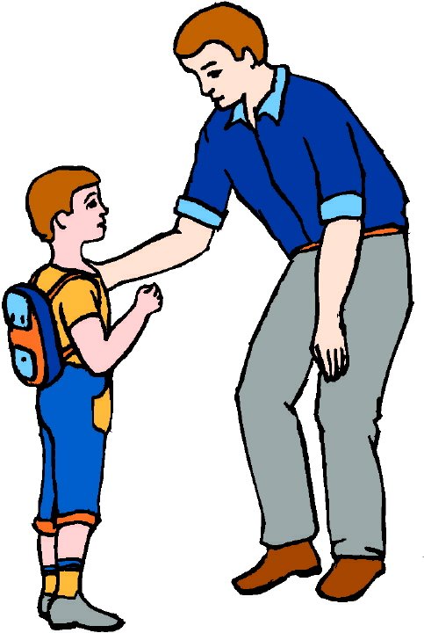
Chapter 13 Vocabulary
πατήρ, πατρός, ὁ
father

Slide 29

Chapter 13 Vocabulary
πίστις, πιστεως, ἡ
faith, belief

Slide 30

Chapter 13 Vocabulary
πνεῦμα, -ατος, τό
spirit, wind

Slide 31

Chapter 13 Vocabulary
σάρξ, σαρκός, ἡ
flesh, body

Slide 32
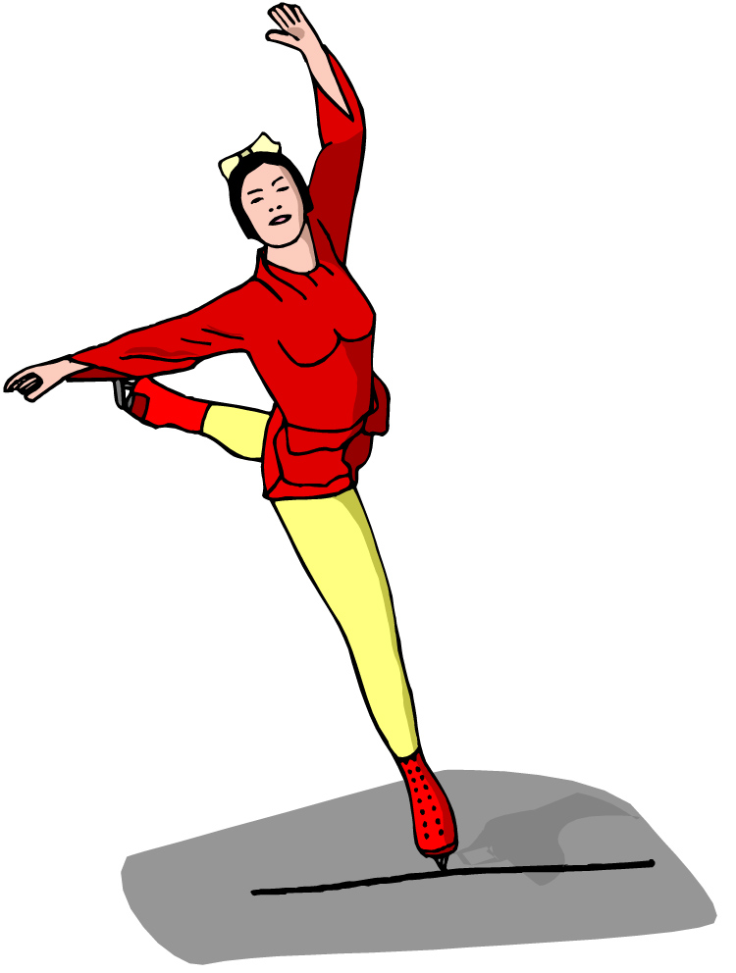
Chapter 13 Vocabulary
χάρις, -ιτος, ἡ
grace, kindness

Slide 33
Congratulations
This is a major milestone in Greek. You now know all the basic declensions for all the nouns in Greek. 2-1-2 and 3.
Wallace notes (p. 35): 28,957 nouns in NT
Nom. Nouns = 7794;
Gen. Nouns = 7681;
Dat. Nouns = 4375;
Acc. Nouns = 8815;
Vocative = 292

Slide 34
Vocabulary Review

Slide 35
Ch. 1 -- Vocabulary
angel, messenger
ἄγγελος, -ου, ὁ
verily, truly
ἀμήν
man, humankind
ἄνθρωπος, -ου, ὁ
I
ἐγώ
God
θεός, -οῦ, ὁ

Slide 36
Ch. 1 -- Vocabulary
and, also, even
καί
heart
καρδία, -ας, ἡ
I say
λέγω
prophet
προφήτης, -ου, ὁ
Christ, Messiah
Χριστός, -οῦ, ὁ

Slide 37
Ch. 2 -- Vocabulary
brother
ἀδελφός, -οῦ, ὁ
I hear, obey
ἀκούω
glory, fame
δόξα, -ης, ἡ
I have
ἔχω
world
κόσμος, -ου, ὁ

Slide 38
Ch. 2 -- Vocabulary
Lord, sir
κύριος, -ου, ὁ
word
λόγος, -ου, ὁ
Peter
Πἑτρος, -ου, ὁ
son
υἱός, -οῦ, ὁ
Pharisee
Φαρισαῖος, -ου, ὁ

Slide 39
Ch. 3 -- Vocabulary
but, yet
ἀλλἀ
apostle, sent one
ἀπόστολος, -ου, ὁ
I see
βλέπω
for, then
γάρ
I know
γινώσκω

Slide 40
Ch. 3 -- Vocabulary
Jesus
Ἰησοῦς, -οῦ, ὁ
I take, receive
λαμβάνω
I loose
λύω
heaven
οὐρανός, -οῦ, ὁ
I believe
πιστεύω

Slide 41
Ch. 4 -- Vocabulary
I love
ἀγαπάω
I write
γράφω
but, and
δέ
servant, slave
δοῦλος, -ου, ὁ
I find
εὑρίσκω

Slide 42
Ch. 4 -- Vocabulary
temple
ἱερόν, -οῦ, τό
People
λαός, -οῦ, ὁ
law
νόμος, -ου, ὁ
house
οἶκος, -ου, ὁ
as, about, how
ὡς

Slide 43
Ch. 5 -- Vocabulary
love
ἀγάπη, -ης, ἡ
truth
ἀλήθεια, -ας, ἡ
sin
ἁμαρτία, -ας, ἡ
kingdom
βασιλεία, -ας, ἡ
writing, Scripture
γραφή, -ῆς, ἡ

Slide 44
Ch. 5 -- Vocabulary
I raise up
ἐγείρω
assembly, church
ἐκκλησία, -ας, ἡ
work
ἔργον, -ου, τό
disciple
μαθητής, -οῦ, ὁ
Hour
ὥρα, -ας, ἡ

Slide 45
Chapter 6 Vocabulary
ἀπό (Gen.)
from
διά (Gen.)
through
διά (Acc.)
on account of
εἰς (Acc.)
into

Slide 46
Chapter 6 Vocabulary
ἐκ (Gen.)
out of, from
ἐν (Dat.)
in
ἐπί (Gen.)
on, over
ἐπί (Dat.)
on, at, against, on the basis of

Slide 47
Chapter 6 Vocabulary
ἐπί (Acc.)
on, to, toward, against
κατά (Gen.)
down, against
κατά (Acc.)
according to
μετά (Gen.)
with

Slide 48
Chapter 6 Vocabulary
μετά (Acc.)
after, behind
περί (Gen.)
about, concerning
περί (Acc.)
around, near
πρός (Acc.)
to

Slide 49
Vocabulary -- Ch. 7
good
ἀγαθός, -ή, -όν
Holy
ἅγιος, -α, -ον
righteous
δίκαιοις, -α, -ον

Slide 50
Vocabulary – Ch. 7
I am
εἰμί
Jewish, a Jew
Ἰουδαῖος, -α, -ον
Great
μέγας, μεγάλη, μέγα

Slide 51
Vocabulary -- Ch. 7
dead
νεκρός, -ά, -όν
no, not
οὐ, οὐκ, οὐχ
first
πρῶτος, -η, -ον
voice
φωνή, -ῆς, ἡ

Slide 52
Vocabulary Ch. 8
he/she/it
αὐτός, -ή, -ό
land, earth, region
γῆ, -ῆς, ἡ
I, we
ἐγώ, ἡμεῖς
day
ἡμέρα, -ας, ἡ
that, so that
ὅτι

Slide 53
Vocabulary Ch. 8
so, then, therefore
οὖν
crowd
ὄχλος, -ου, ὁ
from
παρά (with Gen.)
beside, with
παρά (with Dat.)
alongside, beside
παρά (with Acc.)

Slide 54
Vocabulary Ch. 8
you / you (pl)
σύ / ὑμεῖς
by, at the hands of
ὑπό (with Gen.)
under, below
ὑπό (with Acc.)

Slide 55
Vocabulary Ch. 9
I answer
ἀποκρίνομαι
I send
ἀποστέλλω
I throw
βάλλω
I become
γίνομαι
I come in
εἰσέρχομαι

Slide 56
Vocabulary Ch. 9
I go out
ἐξέρχομαι
I come/go
ἔρχομαι
I wish
θέλω
thus, so
οὕτως
I go
πορεύομαι

Slide 57
Vocabulary Ch. 10
life
ζωή, -ῆς, ἡ
death
θάνατος, -ου, ὁ
I judge
κρίνω
I remain
μένω
only, alone
μόνος, -η, -ον

Slide 58
Vocabulary Ch. 10
now
νῦν
and not, nor
οὐδέ
Paul
Παῦλος
I save
σῴζω
then
τότε

Slide 59
Chapter 11 Vocabulary
ἀπέρχομαι
I go away, leave
ἐκεῖνος
that
Ἰουδαῖος, -α, -ον
Jewish
καθώς
as, just as

Slide 60
Chapter 11 Vocabulary
ὅς, ἥ, ὅ
who, which
ὅταν
when
πάλιν
again
οὗτος, αὗτη, τοῦτο
this

Slide 61
Chapter 11 Vocabulary
Πέτρος, -ου, ὁ
Peter
ὑπέρ
for, about (gen.)
above, beyond (acc.)

Slide 62
Chapter 11 Vocabulary
ὑπέρ
for, about (gen.)
above, beyond (acc.)

Slide 63
Chapter 12 Vocabulary
ἀποθνῄσκω
I die
ἐκεῖ
there
ἕως
until
ἰδού
behold

Slide 64
Chapter 12 Vocabulary
ἵνα
in order that, that
Ἰωάννης, -ου, ὁ
John
μέν
on the one hand, indeed
ὅλος, -η, -ον
whole, entire

Slide 65
Chapter 12 Vocabulary
ὅτε
when
σύν
with

